Slide 1
Does a system of linear equations have solutions?
Hung-yi Lee
Notes:
What is the application that we know solution or not???????????

Slide 2
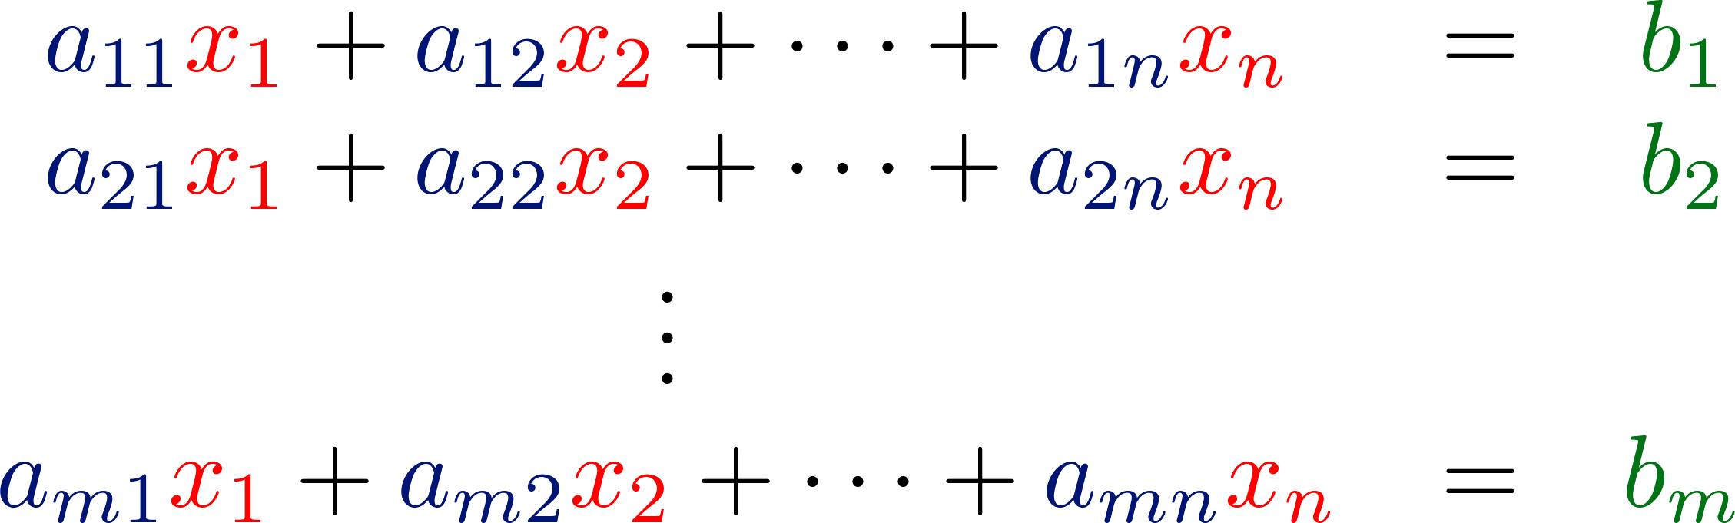

Learning Target
Given A and b, sometimes x exists (having solution), and sometimes doesn’t (no solution)
New terms: “linear combination” and “span”
Review
System of Linear Equations
Matrix-vector product:

Slide 3

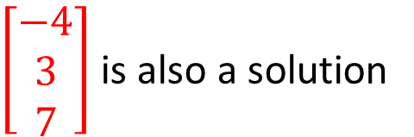

Solution
Given a system of linear equation
$\left[\begin{matrix}2 \\ 5 \\ 1\end{matrix}\right]$ is a solution
$\left[\begin{matrix}−4 \\ 3 \\ 7\end{matrix}\right]$ is also a solution
There are other possible solutions ……
The set of all solutions of a system of linear equations is called the solution set.

Slide 4
Solution
A system of linear equations is called consistent if it has one or more solutions.
A system of linear equations is called inconsistent if its solution set is empty.
Solution set
Consistent or Inconsistent?

Slide 5
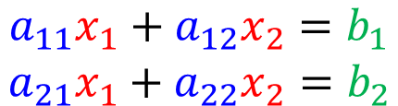
Solution
Considering any system of linear equations with 2 variables and 2 equations
$$\begin{matrix}a_{11}x_{1}+a_{12}x_{2}=b_{1} \\ a_{21}x_{1}+a_{22}x_{2}=b_{2}\end{matrix}$$
…… line 1
…… line 2
Row Aspect
1ine 1
1ine 1
=line 2
1ine 1
1ine 2
1ine 2
unique solution
no solution
infinitely many solution

Slide 6
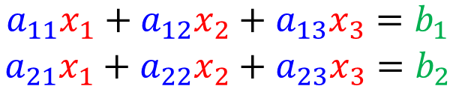
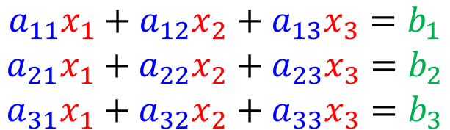
Solution
Considering any system of linear equations with 2 variables and 2 equations
How about 3 variables and 2 equations?
How about 3 variables and 3 equations?
$$\begin{matrix}a_{11}x_{1}+a_{12}x_{2}=b_{1} \\ a_{21}x_{1}+a_{22}x_{2}=b_{2}\end{matrix}$$
…… line 1
…… line 2
$$\begin{matrix}a_{11}x_{1}+a_{12}x_{2}+a_{13}x_{3}=b_{1} \\ a_{21}x_{1}+a_{22}x_{2}+a_{23}x_{3}=b_{2}\end{matrix}$$
$$\begin{matrix}a_{11}x_{1}+a_{12}x_{2}+a_{13}x_{3}=b_{1} \\ a_{21}x_{1}+a_{22}x_{2}+a_{23}x_{3}=b_{2} \\ a_{31}x_{1}+a_{32}x_{2}+a_{33}x_{3}=b_{3}\end{matrix}$$
More Variables?

Slide 7
Does a system of linear equations have solutions?
Linear Combination

Slide 8
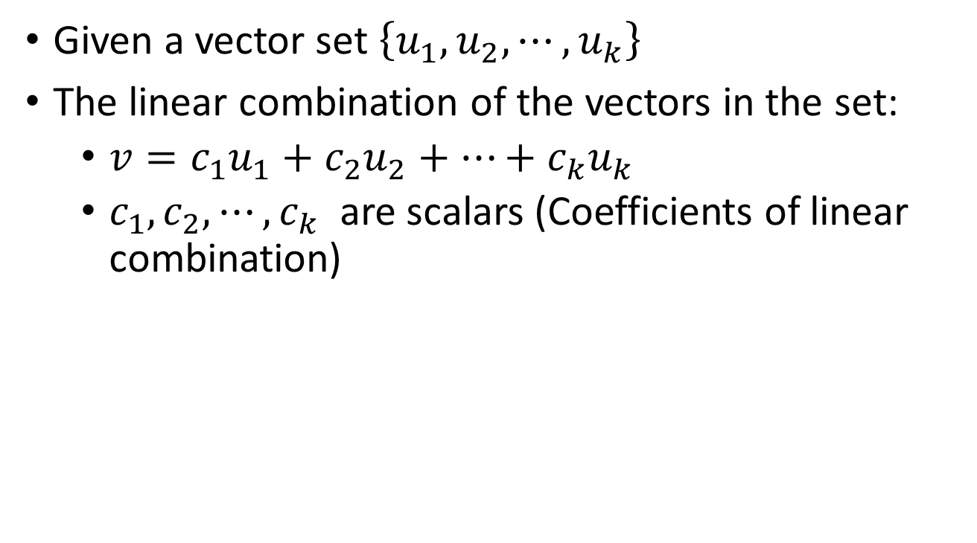

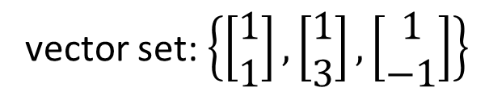
Linear Combination
Given a vector set $\left\{u_{1},u_{2},⋯,u_{k}\right\}$
The linear combination of the vectors in the set:
  $v=c_{1}u_{1}+c_{2}u_{2}+⋯+c_{k}u_{k}$
  $c_{1},c_{2},⋯,c_{k}$ are scalars (Coefficients of linear combination)
vector set: $\left\{\left[\begin{matrix}1 \\ 1\end{matrix}\right],\left[\begin{matrix}1 \\ 3\end{matrix}\right],\left[\begin{matrix}1 \\ −1\end{matrix}\right]\right\}$
coefficients: $\left\{−3,4,1\right\}$
What is the result of linear combination?
Notes:
[2 8]

Slide 9
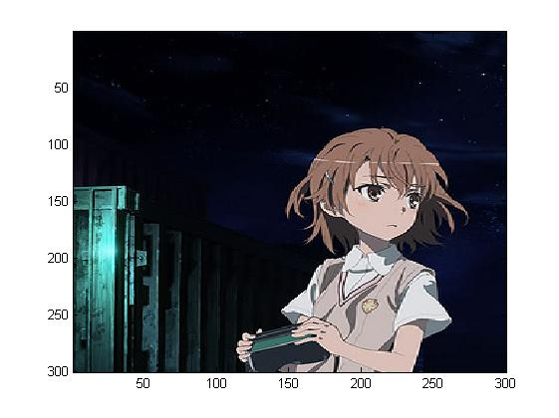
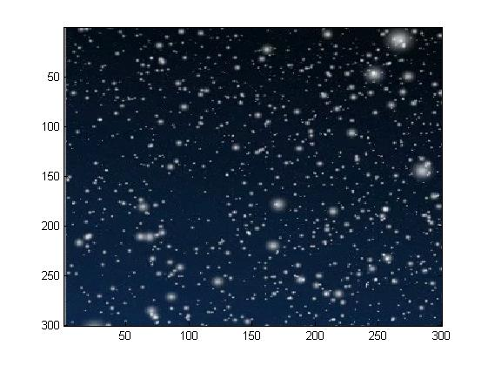
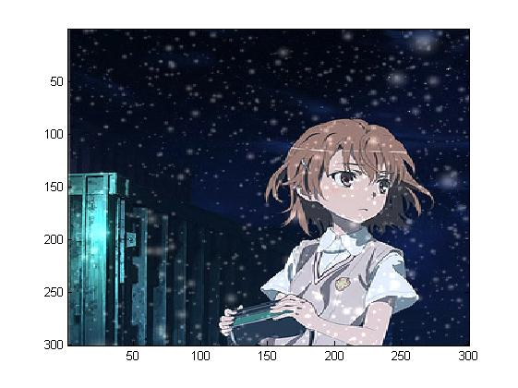



$$u_{1}$$
$$u_{2}$$
$$1∙u_{1}+0.5∙u_{2}=$$

Slide 10
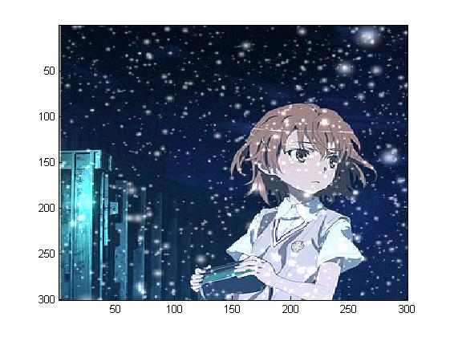

$$u_{1}$$
$$u_{2}$$
$$1∙u_{1}+1∙u_{2}=$$

Slide 11
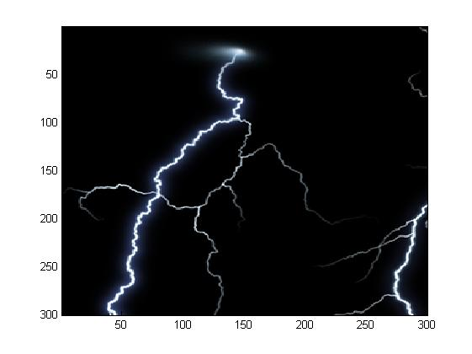
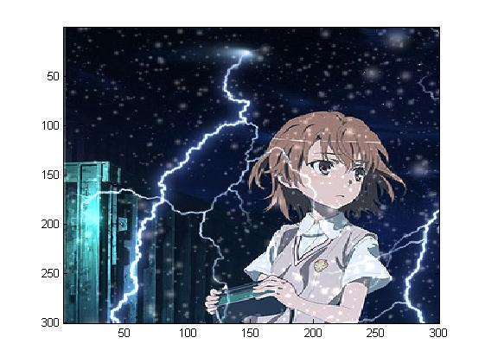


$$u_{1}$$
$$u_{2}$$
$$u_{3}$$
$$1∙u_{1}+0.5∙u_{2}+1∙u_{3}=$$

Slide 12



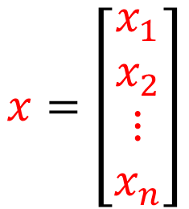



Column Aspect
$$a_{1}$$
$$a_{2}$$
$$a_{n}$$
$$A=\left[\begin{matrix}\begin{matrix}a_{1} & a_{2}\end{matrix} & ⋯ & a_{n}\end{matrix}\right]$$
$$x=\left[\begin{matrix}\begin{matrix}x_{1} \\ x_{2}\end{matrix} \\ ⋮ \\ x_{n}\end{matrix}\right]$$
Vector set
coefficients
Linear Combination
$$=x_{1}a_{1}+x_{2}a_{2}+⋯+x_{n}a_{n}$$
Notes:
[2 8]

Slide 13


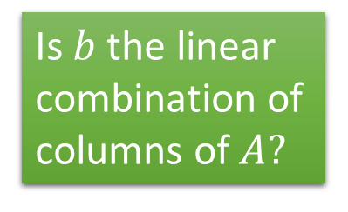
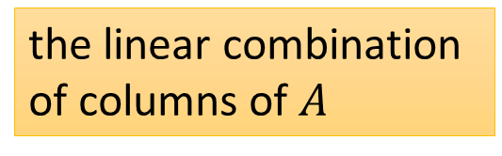
System of Linear Equations v.s.
Linear Combination
Non empty solution set?
Has solution or not?
(A system of linear equations)
Consistent?
The Same question
Column Aspect
Is $b$ the linear combination of columns of $A?$
$$=x_{1}a_{1}+x_{2}a_{2}+⋯+x_{n}a_{n}$$
$$=b$$
the linear combination of columns of $A$
Notes:
The coefficient is the solution

Slide 14


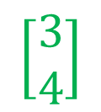


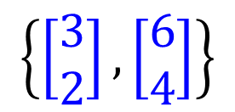


Example 1
$$3x_{1}+6x_{2}=3$$
$$2x_{1}+4x_{2}=4$$
$$A=\left[\begin{matrix}3 & 6 \\ 2 & 4\end{matrix}\right]$$
$$x=\left[\begin{matrix}x_{1} \\ x_{2}\end{matrix}\right]$$
$$b=\left[\begin{matrix}3 \\ 4\end{matrix}\right]$$
Has solution or not?
Is $b$ the linear combination of columns of $A?$
$$\left[\begin{matrix}3 \\ 4\end{matrix}\right]$$
$$\left\{\left[\begin{matrix}3 \\ 2\end{matrix}\right],\left[\begin{matrix}6 \\ 4\end{matrix}\right]\right\}$$
Notes:
高中、大學分隔線

Slide 15






Example 1
$$3x_{1}+6x_{2}=3$$
$$2x_{1}+4x_{2}=4$$
Has solution or not?
Vector set: $\left\{\left[\begin{matrix}3 \\ 2\end{matrix}\right],\left[\begin{matrix}6 \\ 4\end{matrix}\right]\right\}$
Is $\left[\begin{matrix}3 \\ 4\end{matrix}\right]$ a linear combination of $\left\{\left[\begin{matrix}3 \\ 2\end{matrix}\right],\left[\begin{matrix}6 \\ 4\end{matrix}\right]\right\}$?
No
$$\left[\begin{matrix}3 \\ 4\end{matrix}\right]$$
The linear combination is always on the dotted line.
$$\left[\begin{matrix}6 \\ 4\end{matrix}\right]$$
$$\left[\begin{matrix}3 \\ 2\end{matrix}\right]$$

Slide 16
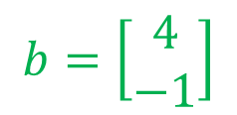
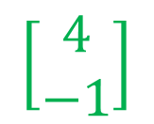


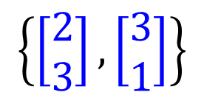

Example 2
$$2x_{1}+3x_{2}=4$$
$$3x_{1}+1x_{2}=−1$$
$$A=\left[\begin{matrix}2 & 3 \\ 3 & 1\end{matrix}\right]$$
$$x=\left[\begin{matrix}x_{1} \\ x_{2}\end{matrix}\right]$$
$$b=\left[\begin{matrix}4 \\ −1\end{matrix}\right]$$
Has solution or not?
Is $b$ the linear combination of columns of $A?$
$$\left[\begin{matrix}4 \\ −1\end{matrix}\right]$$
$$\left\{\left[\begin{matrix}2 \\ 3\end{matrix}\right],\left[\begin{matrix}3 \\ 1\end{matrix}\right]\right\}$$
Notes:
高中、大學分隔線

Slide 17


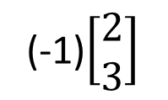
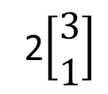
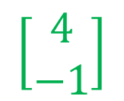
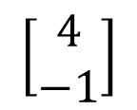
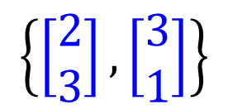


Example 2
$$2x_{1}+3x_{2}=4$$
$$3x_{1}+1x_{2}=−1$$
Has solution or not?
$$\left\{\left[\begin{matrix}2 \\ 3\end{matrix}\right],\left[\begin{matrix}3 \\ 1\end{matrix}\right]\right\}$$
$$\left[\begin{matrix}2 \\ 3\end{matrix}\right]$$
$$\left[\begin{matrix}4 \\ −1\end{matrix}\right]$$
2$\left[\begin{matrix}3 \\ 1\end{matrix}\right]$
$$\left[\begin{matrix}3 \\ 1\end{matrix}\right]$$
$$\left[\begin{matrix}4 \\ −1\end{matrix}\right]$$
(-1)$\left[\begin{matrix}2 \\ 3\end{matrix}\right]$
Notes:
Unique solution
在第二項限如何、在第三項限如何

Slide 18
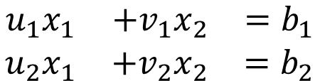


Example 2
How about in R⁴?
If u and v are any nonparallel vectors in R², then every vector in R² is a linear combination of u and v
  Nonparallel: u and v are nonzero vectors, and u ≠ cv.
If u, v and w are any nonparallel vectors in R³, then every vector in R³ is a linear combination of u, v and w?
$$\begin{matrix}u_{1}x_{1} & +v_{1}x_{2} & =b_{1} \\ u_{2}x_{1} & +v_{2}x_{2} & =b_{2}\end{matrix}$$
$$u$$
$$v$$
u and v are not parallel
?
Has solution
Notes:
It is easy to understand for e1 and e2
Unique coefficient
Obviously, every vector in R^{n} may be uniquely linearly combined by these standard vectors.
劍圍???

Slide 19
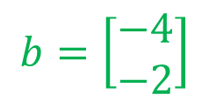
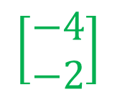


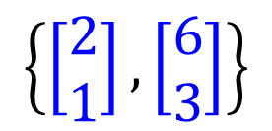

Example 3
$$2x_{1}+6x_{2}=−4$$
$$1x_{1}+3x_{2}=−2$$
$$A=\left[\begin{matrix}2 & 6 \\ 1 & 3\end{matrix}\right]$$
$$x=\left[\begin{matrix}x_{1} \\ x_{2}\end{matrix}\right]$$
$$b=\left[\begin{matrix}−4 \\ −2\end{matrix}\right]$$
Has solution or not?
Is $b$ the linear combination of columns of $A?$
$$\left[\begin{matrix}−4 \\ −2\end{matrix}\right]$$
$$\left\{\left[\begin{matrix}2 \\ 1\end{matrix}\right],\left[\begin{matrix}6 \\ 3\end{matrix}\right]\right\}$$
Notes:
高中、大學分隔線

Slide 20
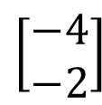





Example 3
$$2x_{1}+6x_{2}=−4$$
$$1x_{1}+3x_{2}=−2$$
Has solution or not?
Vector set: $\left\{\left[\begin{matrix}2 \\ 1\end{matrix}\right],\left[\begin{matrix}6 \\ 3\end{matrix}\right]\right\}$
Is $\left[\begin{matrix}−4 \\ −2\end{matrix}\right]$ a linear combination of $\left\{\left[\begin{matrix}2 \\ 1\end{matrix}\right],\left[\begin{matrix}6 \\ 3\end{matrix}\right]\right\}$?
Yes
$$\left[\begin{matrix}6 \\ 3\end{matrix}\right]$$
$$\left[\begin{matrix}2 \\ 1\end{matrix}\right]$$
$$\left[\begin{matrix}−4 \\ −2\end{matrix}\right]$$
Notes:
Infinite many solutions

Slide 21
Does a system of linear equations have solutions?
Span

Slide 22
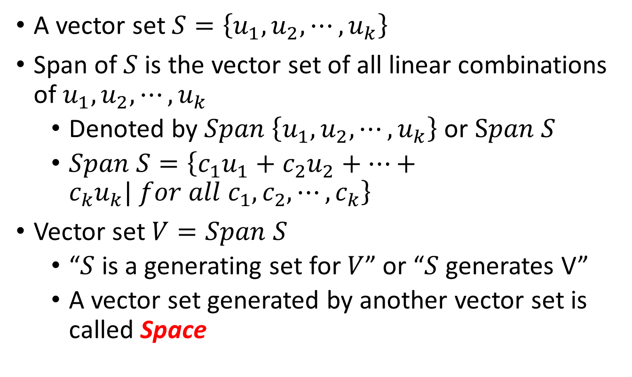
Span
A vector set $S=\left\{u_{1},u_{2},⋯,u_{k}\right\}$
Span of $S$ is the vector set of all linear combinations of $u_{1},u_{2},⋯,u_{k}$
  Denoted by $Span \left\{u_{1},u_{2},⋯,u_{k}\right\}$ or $Span S$
  $Span S=\left\{{c_{1}u}_{1}+{c_{2}u}_{2}+⋯+{c_{k}u}_{k}| for all c_{1},c_{2},⋯,c_{k}\right\}$
Vector set $V=Span S$
  “$S$ is a generating set for $V$” or “$S$ generates V”
  A vector set generated by another vector set is called Space

Slide 23
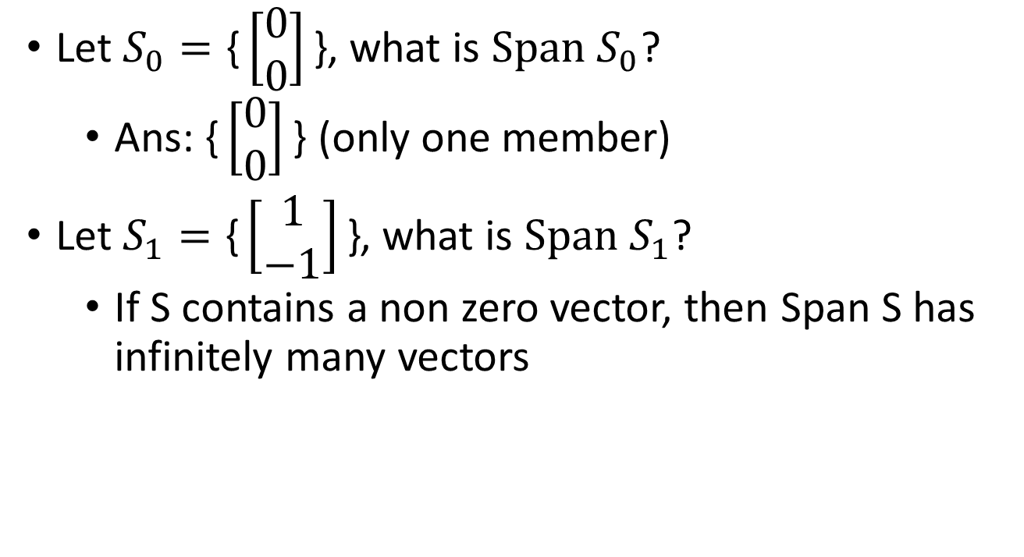


Span
$$Span S_{1}$$
Let $S_{0}=\text{\{}\left[\begin{matrix}0 \\ 0\end{matrix}\right]\text{\}}$, what is $Span S_{0}$?
  Ans: $\text{\{}\left[\begin{matrix}0 \\ 0\end{matrix}\right]\text{\}}$ (only one member)
Let $S_{1}=\text{\{}\left[\begin{matrix}1 \\ −1\end{matrix}\right]\text{\}}$, what is $Span S_{1}$?
  If S contains a non zero vector, then Span S has infinitely many vectors
$$\left[\begin{matrix}1 \\ −1\end{matrix}\right]$$

Slide 24







Span
Let $S_{1}=\text{\{}\left[\begin{matrix}1 \\ −1\end{matrix}\right]\text{\}}$, what is $Span S_{1}$?
Let $S_{2}=\text{\{}\left[\begin{matrix}1 \\ −1\end{matrix}\right],\left[\begin{matrix}−2 \\ 2\end{matrix}\right]\text{\}}$, what is $Span S_{2}$?
$$Span S_{1}$$
$$Span S_{2}$$
$$\left[\begin{matrix}−2 \\ 2\end{matrix}\right]$$
$$\left[\begin{matrix}1 \\ −1\end{matrix}\right]$$
$$\left[\begin{matrix}1 \\ −1\end{matrix}\right]$$
$$Span S_{1}=Span S_{2}$$
(Different number of vectors can generate the same space.)

Slide 25


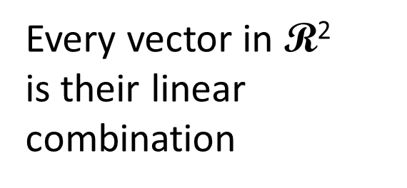




Span
Let $S_{3}=\text{\{}\left[\begin{matrix}1 \\ −1\end{matrix}\right],\left[\begin{matrix}−2 \\ 2\end{matrix}\right],\left[\begin{matrix}2 \\ 1\end{matrix}\right]\text{\}}$, what is $Span S_{3}$?
nonparallel vectors
Every vector in $\text{R}\text{2}$
is their linear combination
$$\left[\begin{matrix}−2 \\ 2\end{matrix}\right]$$
$$\left[\begin{matrix}2 \\ 1\end{matrix}\right]$$
$$\left[\begin{matrix}1 \\ −1\end{matrix}\right]$$
$$Span S_{3}$$
$$=\text{R}\text{2}$$

Slide 26












Span
Let $S_{3}=\text{\{}\left[\begin{matrix}1 \\ −1\end{matrix}\right],\left[\begin{matrix}−2 \\ 2\end{matrix}\right],\left[\begin{matrix}2 \\ 1\end{matrix}\right]\text{\}}$, what is $Span S_{3}$?
Let $S_{4}=\text{\{}\left[\begin{matrix}1 \\ −1\end{matrix}\right],\left[\begin{matrix}−2 \\ 2\end{matrix}\right],\left[\begin{matrix}2 \\ 1\end{matrix}\right],\left[\begin{matrix}−1 \\ 3\end{matrix}\right]\text{\}}$, what is $Span S_{4}$?
$$\left[\begin{matrix}−1 \\ 3\end{matrix}\right]$$
$$\left[\begin{matrix}−2 \\ 2\end{matrix}\right]$$
$$\left[\begin{matrix}2 \\ 1\end{matrix}\right]$$
$$\left[\begin{matrix}−2 \\ 2\end{matrix}\right]$$
$$\left[\begin{matrix}2 \\ 1\end{matrix}\right]$$
$$\left[\begin{matrix}1 \\ −1\end{matrix}\right]$$
$$\left[\begin{matrix}1 \\ −1\end{matrix}\right]$$
$$Span S_{3}$$
$$=\text{R}\text{2}$$
$$Span S_{4}$$
$$=\text{R}\text{2}$$

Slide 27
Span
z
z
y
y
x
x
Notes:
Span{e₃} = z-axis in R³
Span{e₁,e₂} = xy-plane in R³

Slide 28
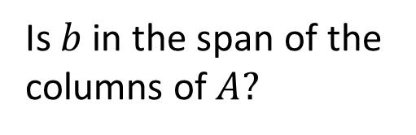
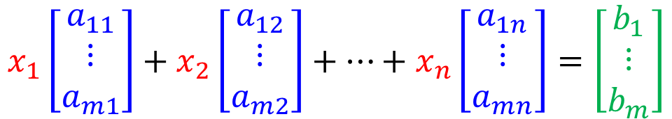
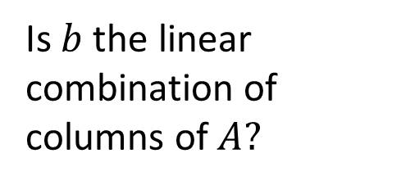
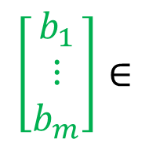
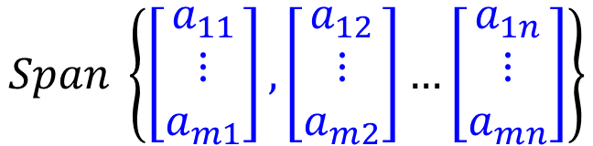
Has solution or not?
The same question
$$x_{1}\left[\begin{matrix}a_{11} \\ ⋮ \\ a_{m1}\end{matrix}\right]+x_{2}\left[\begin{matrix}a_{12} \\ ⋮ \\ a_{m2}\end{matrix}\right]+…+x_{n}\left[\begin{matrix}a_{1n} \\ ⋮ \\ a_{mn}\end{matrix}\right]=\left[\begin{matrix}b_{1} \\ ⋮ \\ b_{m}\end{matrix}\right]$$
Is $b$ the linear combination of columns of $A?$
The same question
$$\left[\begin{matrix}b_{1} \\ ⋮ \\ b_{m}\end{matrix}\right]∈$$
$$Span \left\{\left[\begin{matrix}a_{11} \\ ⋮ \\ a_{m1}\end{matrix}\right],\left[\begin{matrix}a_{12} \\ ⋮ \\ a_{m2}\end{matrix}\right]…\left[\begin{matrix}a_{1n} \\ ⋮ \\ a_{mn}\end{matrix}\right]\right\}$$
Is $b$in the span of the columns of $A?$

Slide 29


Summary
Does a system of linear equations have solution?
YES
Have solution
Is $b$ a linear combination of columns of $A$?
Is $b$ in the span of the columns of $A$?
NO
No solution

Slide 30
Acknowledgement
感謝 陳鴻智 同學發現投影片上的錯誤

Slide 31

Eigenface

